Slide 1
Solving Map Coloring
Problem Using Genetic Algorithm

Slide 2
Content
Problem Definition
Application of Graph Coloring
Solution
GA Introduction
How GA works
Strength of GA
Limitation of GA
Application
Uses
Map coloring & GA
References

Slide 3
Problem Definition
Graph Coloring is a special case of graph labeling; it is a way of coloring the vertices of a graph such that no two adjacent vertices share the same color; this is called a vertex coloring. Similarly, an edge coloring assigns a color to each edge so that no two adjacent edges share the same color, and a face coloring of a planar graph assigns a color to each face or region so that no two faces that share a boundary have the same color.

Slide 4
Map coloring problem is a constraint satisfaction problem (CSP) to color the areas in a map using predefined number of colors so that the neighboring areas are in different colors. Graph vertex coloring problem is a CSP to color the vertices of a graph using predefined number of colors so that the vertices that are connected by an edge are in different colors. Most of the CSPs belong to a class of problems that are called NP-hard problems, for which no efficient method is known. Map or graph coloring problem is one of them.

Slide 5
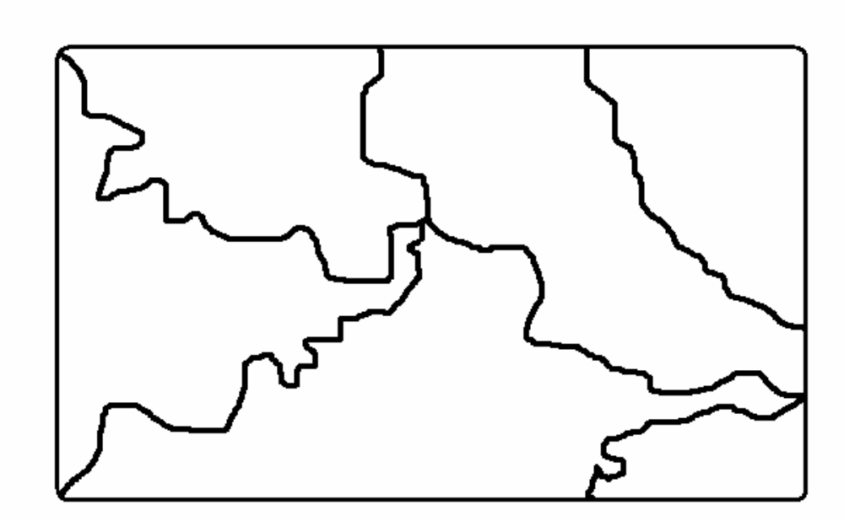

Slide 6
Application of Graph Coloring
Scheduling
Register allocation
Pattern Matching

Slide 7
Solution
To Solve the Map Color Problem we will use the Genetic Algorithm. Because genetic algorithm are being used extensively in optimization problem as an alternative to traditional heuristics.

Slide 8
Genetic Algorithm approach to solve the problem
Initialization
Evaluation (Fitness function)
Selection
Crossover/recombination
Mutation
Evaluate child and Go to Step 3 until termination criteria satisfies

Slide 9
Introduction
Idea of evolutionary computing was introduced in the 1960s by I. Rechenberg in his work "Evolution strategies". His idea was then developed by other researchers. Genetic Algorithms (GAs) were invented by John Holland and developed by him and his students and colleagues. This lead to Holland's book "Adaption in Natural and Artificial Systems" published in 1975.

Slide 10
Genetic algorithm
A genetic algorithm (GA) is a search technique used in computing to find exact or approximate solutions to optimization and search problems. Genetic algorithms are categorized as global search heuristics. Genetic algorithms are a particular class of evolutionary algorithms (also known as evolutionary computation) that use techniques inspired by evolutionary biology such as inheritance, mutation, selection, and crossover (also called recombination).

Slide 11
How GA Work
1. The algorithm begins by creating a random initial population.
2. The algorithm then creates a sequence of new populations. At each step, the algorithm uses the individuals in the current generation to create the next population. To create the new population, the algorithm performs the following steps:
a. Scores each member of the current population by computing its fitness value.

Slide 12
b. Scales the raw fitness scores to convert them into a more usable range of values.
c. Selects members, called parents, based on their fitness.
d. Some of the individuals in the current population that have lower fitness are chosen as elite. These elite individuals are passed to the next population.
e. Produces children from the parents. Children are produced either by making random changes to a single parent—mutation—or by combining the vector entries of a pair of parents—crossover.

Slide 13
f. Replaces the current population with the children to form the next generation.
3. The algorithm stops when one of the stopping criteria is met.

Slide 14
Strengths of GAs
The first and most important point is that genetic algorithms are intrinsically parallel. Most other algorithms are serial and can only explore the solution space to a problem in one direction at a time, and if the solution they discover turns out to be suboptimal, there is nothing to do but abandon all work previously completed and start over. However, since GAs have multiple offspring, they can explore the solution space in multiple directions at once.

Slide 15
Strengths of GAs cont’d
Another notable strength of genetic algorithms is that they perform well in problems for which the fitness landscape is complex - ones where the fitness function is discontinuous, noisy, changes over time, or has many local optima. Most practical problems have a vast solution space, impossible to search exhaustively; the challenge then becomes how to avoid the local optima - solutions that are better than all the others that are similar to them, but that are not as good as different ones elsewhere in the solution space.

Slide 16
Strengths of GAs cont’d
Another area in which genetic algorithms excel is their ability to manipulate many parameters simultaneously
Finally, one of the qualities of genetic algorithms which might at first appear to be a liability turns out to be one of their strengths: namely, GAs know nothing about the problems they are deployed to solve.

Slide 17
Limitation of GA
Although genetic algorithms have proven to be an efficient and powerful problem-solving strategy, they are not a panacea. GAs do have certain limitations
The first, and most important, consideration in creating a genetic algorithm is defining a representation for the problem. The language used to specify candidate solutions must be robust; i.e., it must be able to tolerate random changes such that fatal errors or nonsense do not consistently result.

Slide 18
Limitation of GA cont’d
The problem of how to write the fitness function must be carefully considered so that higher fitness is attainable and actually does equate to a better solution for the given problem. If the fitness function is chosen poorly or defined imprecisely, the genetic algorithm may be unable to find a solution to the problem, or may end up solving the wrong problem.

Slide 19
Limitation of GA cont’d
In addition to making a good choice of fitness function, the other parameters of a GA - the size of the population, the rate of mutation and crossover, the type and strength of selection - must be also chosen with care. If the population size is too small, the genetic algorithm may not explore enough of the solution space to consistently find good solutions. If the rate of genetic change is too high or the selection scheme is chosen poorly, beneficial schema may be disrupted and the population may enter error catastrophe, changing too fast for selection to ever bring about convergence.

Slide 20
Application
1. Timetabling problems, such as designing a non- conflicting class timetable for a large university.
2. Training artificial neural networks when pre-classified training examples are not readily obtainable (neuroevolution).
3. Traveling Salesman Problem
4. Automated design of sophisticated trading systems in the financial sector.

Slide 21
Application cont’d
5. Calculation of Bound states and Local-density approximations.
6. Code-breaking, using the GA to search large solution spaces of ciphers for the one correct decryption.
7. Design of water distribution systems

Slide 22
Uses
GAs have been used for problem-solving and for modelling .
Optimization: GAs have been used in a wide variety of optimisation tasks, combinatorial optimisation problems such as traveling salesman problem(TSP), circuit design , job shop scheduling .
Automatic Programming: GAs have been used to evolve computer programs for specific tasks, and to design other computational structures, for example, cellular automata and sorting networks.

Slide 23
Uses cont’d
Machine and robot learning
Economic models
Immune system models
Ecological models
Population genetics models
Interactions between evolution and learning
Models of social systems

Slide 24
Map coloring and GA
To solving the Map Color Problem a plane is divided in to many regions. These regions have to be colored in such a way that no two adjacent regions have the same color. The main limitation is that we have to use only two colors.

Slide 25
Genetic Algorithm Approach
There are seven steps:
Start with a population of n random individuals each with 1-bit chromosomes.
Calculate the fitness f(x) of each individual.
Choose, based on fitness, two individuals and call them parents. Remove the parent from the population.
Use a random process to determine whether to perform crossover as the children. If not, Simply refer to the parents as the children.

Slide 26
5.Mutate the children with probability of mutation for each bit.
6. Put the two children into an empty set called the new generation.
7. Return to Step 2 until the new generation contaons n individuals. Delete one child at random if nis odd. Then replace the old population with the new generation.Return to Step 1.

Slide 27
Map color Problem Representation
To solve the Map color problem, a map is considered (fig-1) which is divided into six regions; each region is represented by alphabets A,B,C,D,E and F respectively. The complete map with the help of these alphabets is represented in the form of a graph(fig-2).

Slide 28
Fig-1

Slide 29
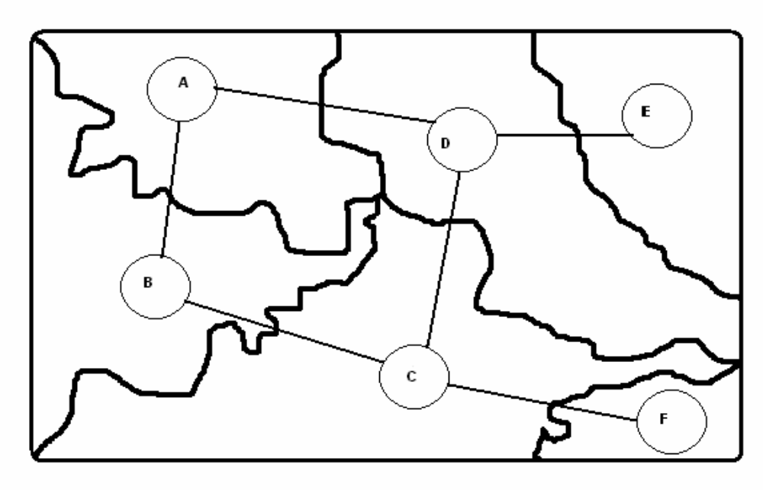
Fig-2

Slide 30
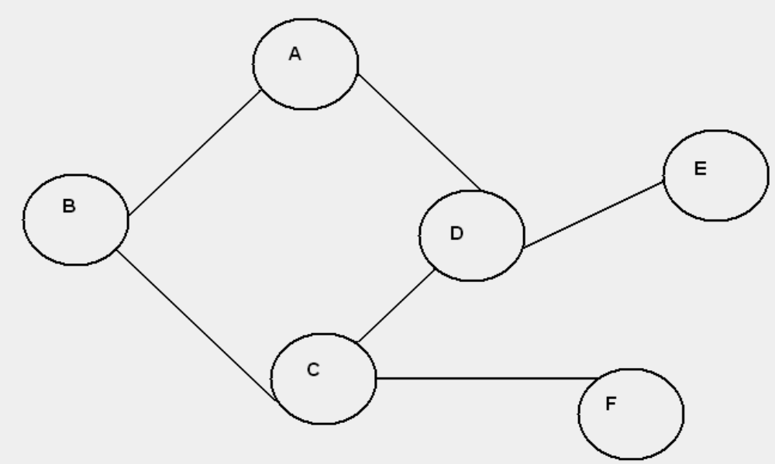
Fig.-3

Slide 31
Adjacency Matrix of the Graph
Nodes | A | B | C | D | E | F
A | 0 | 1 | 0 | 1 | 0 | 0
B | 1 | 0 | 1 | 0 | 0 | 0
C | 0 | 1 | 0 | 1 | 0 | 1
D | 1 | 0 | 1 | 0 | 1 | 0
E | 0 | 0 | 0 | 1 | 0 | 0
F | 0 | 0 | 1 | 0 | 0 | 0

Slide 32
Nodes with Adjacent Vertexes
Nodes | Adjacent vertexes
A | B,D
B | A,C
C | B,D,F
D | A,C,E
E | D
F | C

Slide 33
Genetic Algorithm approach to solve the problem
Initialization
Evaluation (Fitness function)
Selection
Crossover/recombination
Mutation
Evaluate child and Go to Step 3 until termination criteria satisfies

Slide 34
Initialisation of parent population
Generate the M number of solution string known as parent population
Mostly random
In generated chromosomes 0 represents white color while 1 represent black color.

Slide 35
Here 4 chromosomes a, b,c and d are generated randomly with the help of a function
a | 1 | 0 | 1 | 1 | 0 | 1
b | 0 | 0 | 1 | 0 | 1 | 1
c | 1 | 0 | 1 | 0 | 1 | 1
d | 0 | 1 | 0 | 0 | 1 | 1

Slide 36
Evaluation
These four chromosomes are evaluated by a fitness function.
Fitness function
For each of the vertex (table-1(b)), its color is checked with its adjacent vertexes. If the color of adjacent vertexes are not same as compared to the vertex for which it is compared, fitness is increased by 1, Let us consider the first randomly generated chromosome a,
Node- A B C D E F
a | 1 | 0 | 1 | 1 | 0 | 1

Slide 37
Fitness
Parent Population | Fitness
a | 2
B | 2
C | 4
d | 3

Slide 38
Selection
In genetic algorithm fit solution are likely to survive and bad solution are likely to die off. So some of the best fit chromosomes are selected from parent population according to some selection criteria (e.g. Roulette wheel selection). Selected chromosomes are as follows:

Slide 39
Selection
Fitness
C1 | 1 | 0 | 1 | 0 | 1 | 1 | 4
D1 | 1 | 0 | 1 | 0 | 1 | 1 | 3
D2 | 1 | 0 | 1 | 0 | 1 | 1 | 3
C2 | 1 | 0 | 1 | 0 | 1 | 1 | 2

Slide 40
Crossover/Recombination
Selected solution are used for crossover. Here C1 and D1 are crossed over
C1 | 1 | 0 | 1 | 0 | 1 | 1
D1 | 0 | 1 | 0 | 0 | 1 | 1

Slide 41
After cross over we find two child chromosomes E1 and F1
E1 | 0 | 1 | 1 | 0 | 1 | 1
F1 | 0 | 1 | 0 | 0 | 1 | 1

Slide 42
Similarly chromosomes D2 and C2 are crossed over
D2 | 0 | 1 | 0 | 0 | 1 | 1
C2 | 1 | 0 | 1 | 1 | 0 | 1

Slide 43
After crossover we find two child chromosomes G1 and H1
G1 | 1 | 0 | 1 | 0 | 1 | 1
H1 | 0 | 1 | 0 | 1 | 0 | 1

Slide 44
Mutation
Change the value of an allele of solution with some small probability value e.g. 1%
Motivation is to explore new point in the solution space

Slide 45
Child population after crossover
E1 | 0 | 1 | 1 | 0 | 1 | 1
F1 | 1 | 0 | 0 | 0 | 1 | 1
G1 | 1 | 0 | 1 | 0 | 1 | 1
H1 | 0 | 1 | 0 | 1 | 0 | 1

Slide 46
Child population after mutation
E1 | 0 | 1 | 1 | 0 | 1 | 1
F1 | 1 | 0 | 0 | 0 | 1 | 0
G1 | 1 | 0 | 1 | 0 | 1 | 1
H1 | 0 | 1 | 0 | 1 | 0 | 1

Slide 47
Replace with parent population and repeat process
Here E1,F1, G1, and H1 child population are evaluated and replaced with parent population a,b,c and d. After evaluation , if the required result is found, the process is terminated otherwise the process is restarted from step selection.

Slide 48
Replaced parent population Fitness
E1 | 1
F1 | 2
G1 | 4
H1 | 6

Slide 49

Resultant Map is Shown with two color

Slide 50
References
Wikipedia
An overview of genetic algorithms for the solution of optimization problems By Simon Mardle and Sean Pascoe
  University of Portsmouth.
Multiobjective optimization using Evolutioary Algorithms by Kalyanmoy Deb.
Genetic Algorithm and Evolutionary Computation by Adam Amrczyk.
David E. Goldberg. 1989. Genetic Algorithms in search, optimisation and machine learning.

Slide 51
References
Mitchell, M.(1998). An introduction to genetic Algorithm. MIT Press.
Kalyanmoy Deb, 1995. Optimization for engineering design(PHI).

